Slide 1
 | Month 1 | Month 2 | Month 3 | Month 4 | Month 5
Requirement analysis
Proposal submission
Coding
Testing
Report and powerpoint presentation

Slide 2
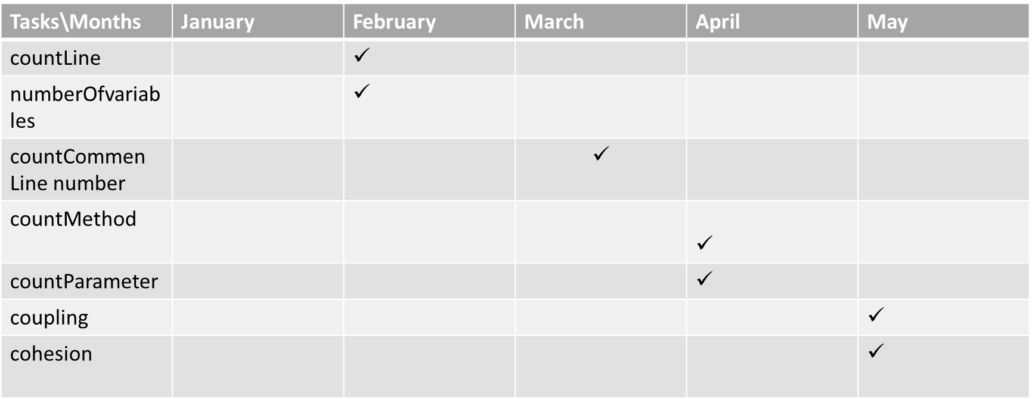
Tasks\Months | January | February | March | April | May
countLine |  | ✓
numberOfvariables |  | ✓
countCommen Line number |  |  | $$✓$$
countMethod |  |  |  | ✓
countParameter |  |  |  | ✓
coupling |  |  |  |  | ✓
cohesion |  |  |  |  | ✓

